Slide 1
Semi-supervised Semantic Segmentation with Error Localization Network
CVPR 2022
Donghyeon Kwon Suha Kwak
Dept. of CSE, POSTECH1 Graduate School of AI, POSTECH2
2023/01/05 陳柏諭
Notes:
大家好我今天要報告的是Semi-supervised Semantic Segmentation with Error Localization Network，他是CVPR 2022的論文

Slide 2
Outline
Introduction
Related Work
Methodology
Experiments
Conclusion

Slide 3
Introduction

Slide 4
Introduction
Collecting training data for semantic segmentation is labor-intensive and time-consuming due to the prohibitive cost of pixel-wise class labeling, which often leads to a dataset limited in terms of the number of annotated data and class diversity.
This paper studies semi-supervised learning of semantic segmentation, which assumes that only a subset of training images are assigned segmentation labels while the others remain unlabeled.
Notes:
收集sematic segmentation 的訓練資料是耗費體力且花費時間的，因為pixel wise class labeling 成本很昂貴，所以很常限制了dataset的標記數量跟類別的多樣性。
這篇論文研究的是半監督學習應用在sematic segmentation上，該方法假設只有訓練圖像的子集被分配了segmentation labels ，而其它則仍是unlabeled。

Slide 5
Introduction
Undoubtedly, the key to the success of this task is to utilize the unlabeled images effectively. Self-training [5, 27, 35, 49] and contrastive learning [3, 29, 51, 52] are techniques commonly used for the purpose in literature.
Self-training generates pseudo labels of unlabeled images using a model trained on labeled ones, and uses them for supervised learning.
Meanwhile, contrastive learning forces feature vectors corresponding to the same pseudo label to be close to each other.
Notes:
毫無疑問，這個任務成功的關鍵在於有效地利用未標記的圖像，Self training 跟 contrastive learning在這些文獻中是常見用來解決剛剛提到的問題的技術
Self training 是使用在label data 上訓練的 model 生成 unlabeled data的pseudo label，並將其用於supervised learning。
Contrastive learning 讓有相同pseudo label 對應的 feature vector 更接近。

Slide 6
Introduction
Although these techniques have improved the performance of semi supervised semantic segmentation substantially, they share a common drawback: Since predictions for unlabeled images are usually corrupted by errors, learning using such predictions as supervision causes confirmation bias towards the errors and returns corrupted models consequently.
Notes:
儘管這些技術在很大程度上提高了sematic segmentation的性能，但它們都有一個共同的缺點：由於unlabeled image的prediction通常受到錯誤的影響，使用這些prediction來訓練可能會造成confirmation bias，進而返回受損的model。

Slide 7
Introduction
We present a novel method that is also dedicated to handling errors on pseudo labels yet better generalizes to those of arbitrary unlabeled images.
The core of our method is the error localization network (ELN), which identifies pixels with erroneous pseudo labels in the form of binary segmentation.
As will be demonstrated empirically, simply disregarding invalid pseudo labels, instead of correcting them, is sufficient to alleviate the confirmation bias and to learn accurate segmentation models.
Notes:
這篇文章提出了一個方法，它專注於處理pseudo label上的錯誤，並且更好的generalizes到任意unlabeled data。
這篇文章提出的方法叫做error localization network (ELN) ，該方法會辨識具有錯誤pseudo label的pixel然後用binary segmentation表示。
根據實驗結果，簡單忽視錯誤的pseudo label而不是修正他們，就足以減輕confirmation bias並學習準確的segmentation models。

Slide 8
Related Work

Slide 9
Self-correction networks for semi-supervised semantic segmentation
A recent approach deals with errors on pseudo labels by learning and exploiting an auxiliary network that corrects the errors [27, 35].
This model, called error correction network (ECN), they presented networks that correct errors of pseudo labels by learning the difference between predicted and ground truth segmentation labels.
However, it is challenging to train such networks effectively in the semi-supervised learning setting since the segmentation network is quickly overfitted to the labeled data, leading to a poor generalization of correction networks.
Notes:
最近的一種方法處理pseudo label上的錯誤， 那它叫做為錯誤校正網絡（ECN），通過學習predicted and ground truth之間的差異，來糾正虛擬標籤的錯誤。
然而，在半監督學習的情境中，要有效地訓練這樣的網絡是具有挑戰性的，因為segmentation network很容易對label data overfitting，從而導致error correction network的泛化效果不佳。

Slide 10
Methodology

Slide 11
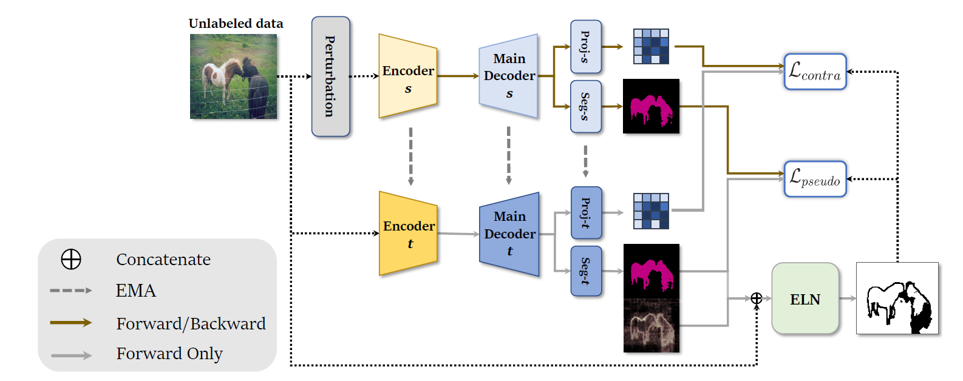
Semi-supervised learning framework incorporating ELN
Notes:
它使用兩個segmentation network，student model，將成為我們的最終模型，teacher model，用於生成pseudo label。 Student model 使用teacher model 的 predict 的pseudo label進行兩種不同的方式訓練，即self-training和contrastive loss。 具體而言，Decoder有兩個head，一個用於segmentation ，另一個用於feature embedding
Then the teacher is updated by an exponential moving average (EMA) of the student

Slide 12
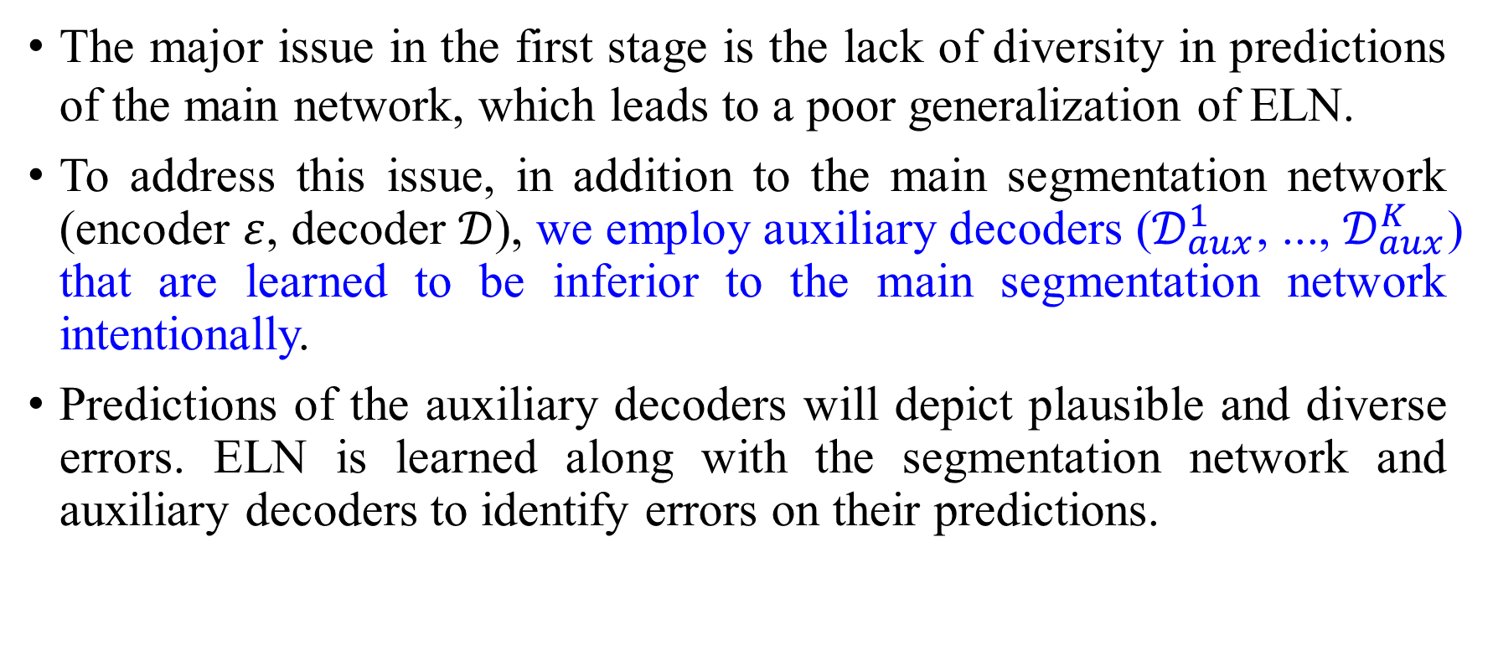
Learning ELN using labeled data
The major issue in the first stage is the lack of diversity in predictions of the main network, which leads to a poor generalization of ELN.
To address this issue, in addition to the main segmentation network (encoder $ε$, decoder $𝒟$), we employ auxiliary decoders ($𝒟_{aux}^{1}$, ..., $𝒟_{aux}^{K}$) that are learned to be inferior to the main segmentation network intentionally.
Predictions of the auxiliary decoders will depict plausible and diverse errors. ELN is learned along with the segmentation network and auxiliary decoders to identify errors on their predictions.
Notes:
這個方法的框架包含兩個階段，第一階段使用label data學習ELN，第二階段是進行帶有ELN的Semi supervised learning。
第一階段他想解決的是main segmentation network的多樣性不足
那它的解決方法就是使用多個輔助Decoder，然後有意的讓他們的能力不及main segmentation network.
輔助的decoder將呈現出合理且多樣的錯誤。ELN會跟著segmentation network和auxiliary decoders一同學習，以辨識它們的預測中的錯誤。

Slide 13
Semi-supervised learning with ELN
In the second stage, the trained ELN is then used for semi-supervised learning of semantic segmentation, where unlabeled images are exploited in two ways, self-training, and contrastive learning.
The role of ELN is to identify pixels whose pseudo labels are likely to be erroneous so that we disregard such pixels in the process of self-training and contrastive learning for stable and effective training.
Notes:
在第二階段，已經訓練好的ELN會被用於semi-supervised的sematic segmentation，其中unlabeled data會被用來做self training跟contrastive learning
ELN的用途是辨識可能存在錯誤pseudo label的pixel，以便在self training和contrastive learning的過程中忽略這些pixel，以實現穩定且有效的訓練。

Slide 14
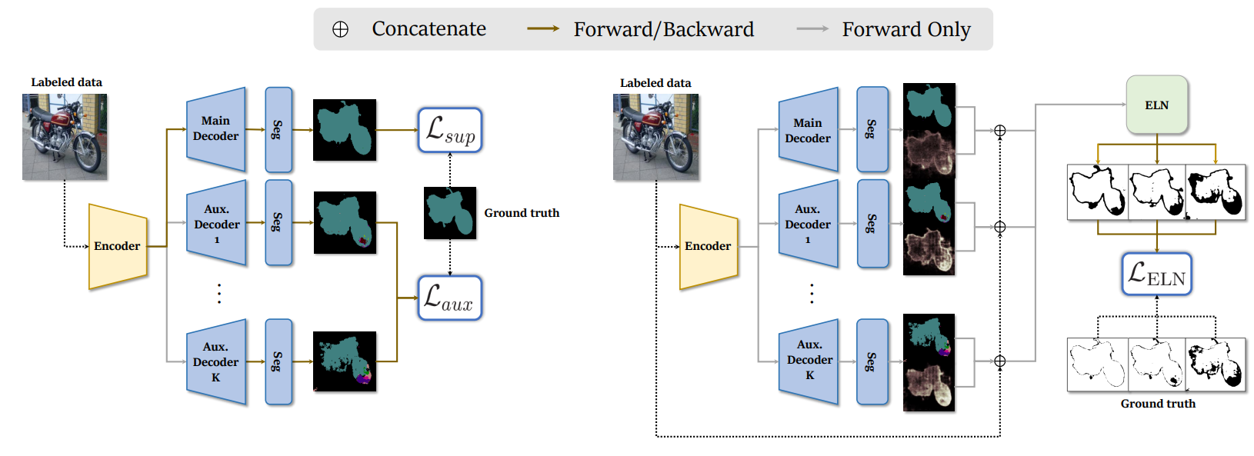
The overall procedure of ELN training
Notes:
訓練 ELN 與主分割網絡和輔助解碼器一同進行（左圖）。
主分割網絡使用普通的交叉熵損失 Lsup 進行訓練，但輔助解碼器使用受限制的交叉熵損失 Laux 進行訓練，使其不如主分割網絡，並且它們的預測有意包含合理且多樣的錯誤。
所有解碼器的所有預測都被用作 ELN 的訓練輸入（右圖），
ELN 學習定位預測中的錯誤。請注意，為了簡潔起見，雖然在這個圖中它們的訓練過程是分開繪製的，但 ELN 和其他組件是同時進行訓練的。

Slide 15
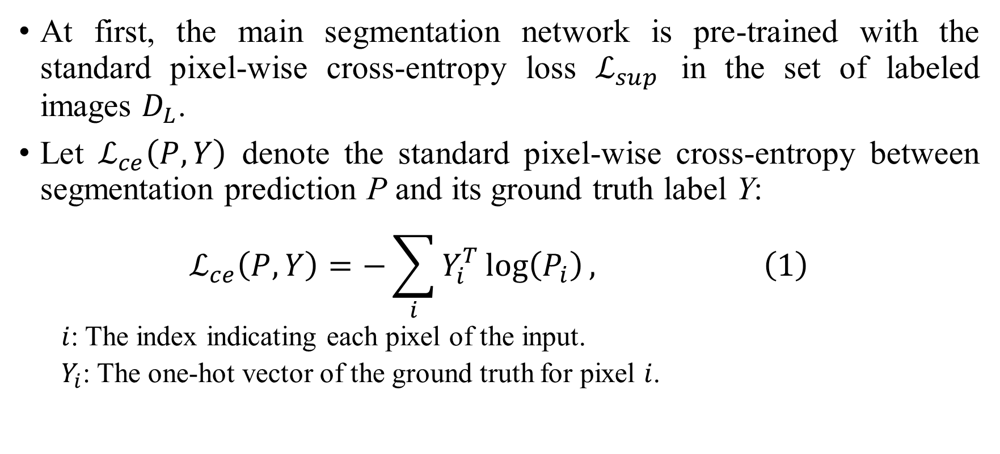
Pre-trained of main segmentation network
At first, the main segmentation network is pre-trained with the standard pixel-wise cross-entropy loss $ℒ_{sup}$ in the set of labeled images $D_{L}$.
Let $ℒ_{ce}\left(P, Y\right)$ denote the standard pixel-wise cross-entropy between segmentation prediction P and its ground truth label Y:
$$ℒ_{ce}\left(P, Y\right)=−\sum_{i}{Y_{i}^{T}\log\left(P_{i}\right), \left(1\right)}$$
$i$: The index indicating each pixel of the input.
$Y_{i}$: The one-hot vector of the ground truth for pixel $i$.

Slide 16
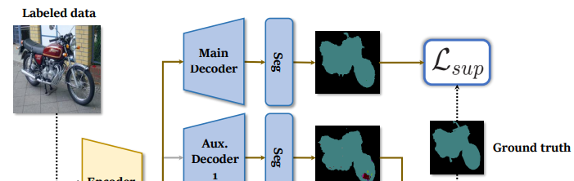
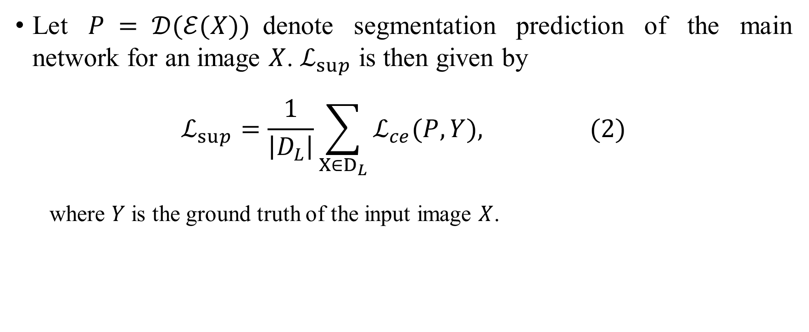
Pre-trained of main segmentation network
Let $P = 𝒟(ℰ(X))$denote segmentation prediction of the main network for an image $X$. $ℒ_{sup}$ is then given by
$$ℒ_{sup}=\frac{1}{\left|D_{L}\right|}\sum_{X∈D_{L}}{ℒ_{ce}(P,Y), (2)}$$
where $Y$ is the ground truth of the input image $X$.

Slide 17
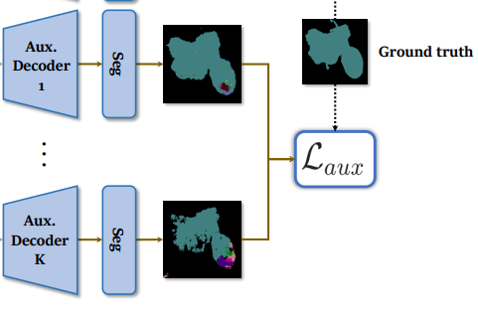
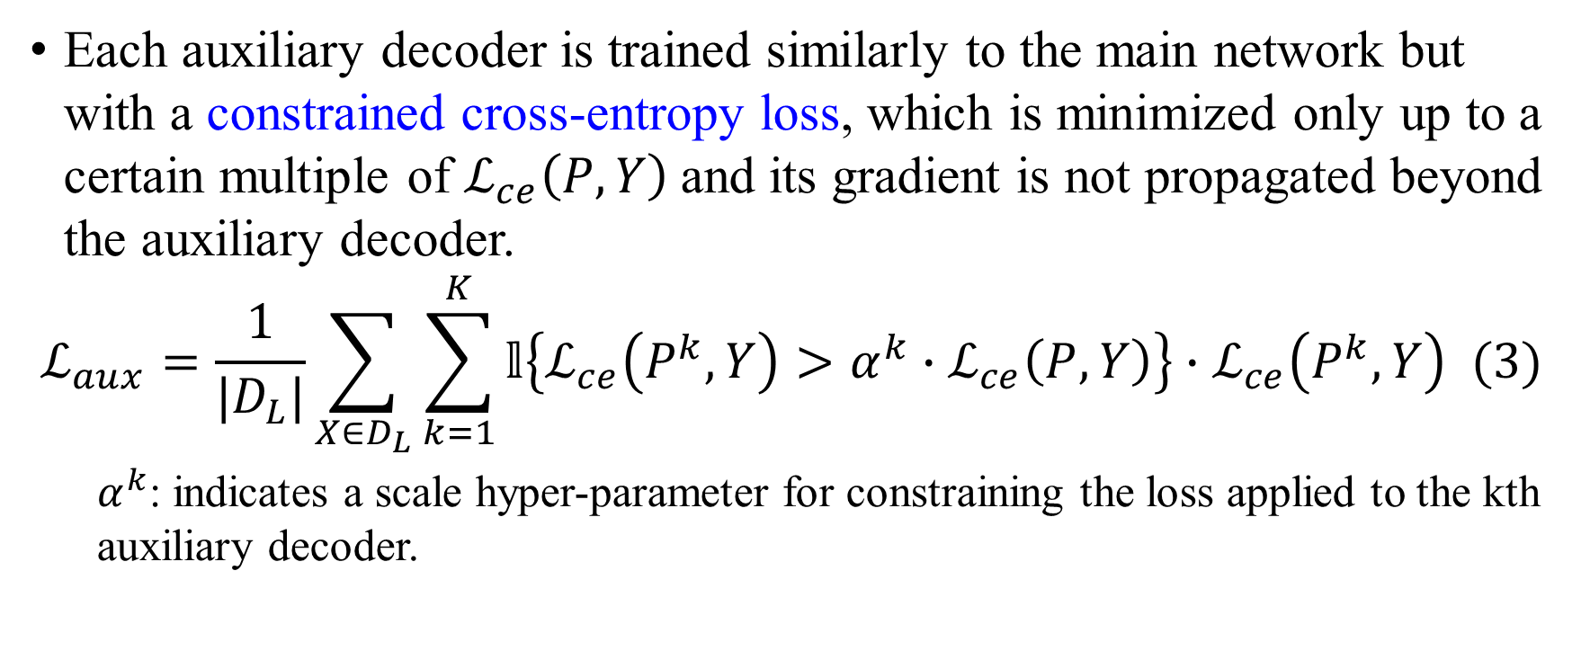
Training of auxiliary decoder
Each auxiliary decoder is trained similarly to the main network but with a constrained cross-entropy loss, which is minimized only up to a certain multiple of $ℒ_{ce}\left(P, Y\right)$and its gradient is not propagated beyond the auxiliary decoder.
$$ℒ_{aux}=\frac{1}{|D_{L}|}\sum_{X∈D_{L}}{\sum_{k=1}^{K}{𝕝\left\{ℒ_{ce}\left(P^{k},Y\right)>α^{k}∙ℒ_{ce}\left(P,Y\right)\right\}∙ℒ_{ce}\left(P^{k},Y\right) (3)}}$$
$α^{k}$: indicates a scale hyper-parameter for constraining the loss applied to the kth auxiliary decoder.
Notes:
每個輔助decoder都是使用了受限制的Cross entropy loss來訓練的
讓大K 表示所有輔助decoder的數量，小k 表示它們的index。那麼 K 個輔助decoder的total loss，Laux，可以由以下公式給出：
$α^{k}$是一個scale的超參數用來限制地k個輔助decoder的loss
只有當kth decoder的CE loss大於main segmentation的CE loss乘上alpha k這個超參數時他的權重才是1否則為0
以這種方式訓練輔助Decoder可以讓它們能夠生成可能錯誤的predict，這些predict被用作ELN的training input。
P k = Dk (E(X)) denotes segmentation prediction of the kth decoder
the set of labeled images $D_{L}$

Slide 18
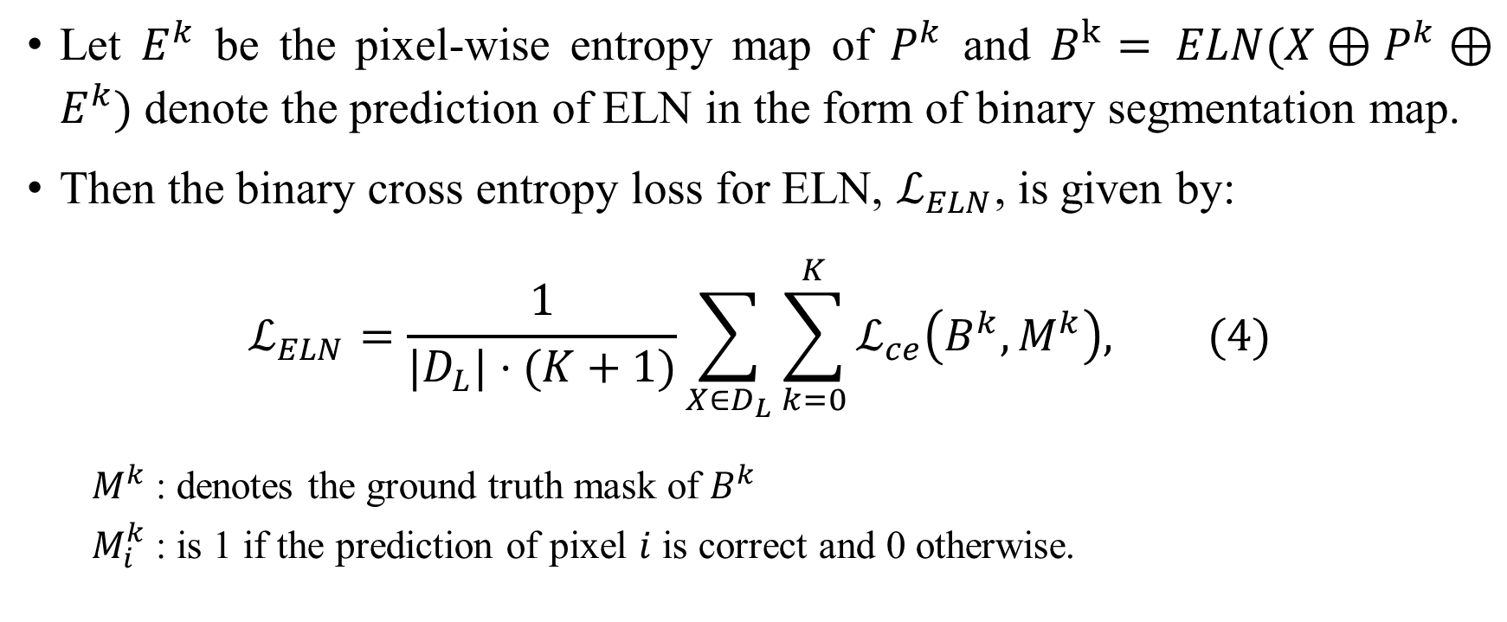
The loss function of ELN
Let $E^{k}$ be the pixel-wise entropy map of $P^{k}$ and $B^{k}= ELN(X⊕P^{k}⊕E^{k})$denote the prediction of ELN in the form of binary segmentation map.
Then the binary cross entropy loss for ELN, $ℒ_{ELN}$, is given by:
$$ℒ_{ELN}=\frac{1}{|D_{L}|⋅(K+1)}\sum_{X∈D_{L}}{\sum_{k=0}^{K}{ℒ_{ce}\left(B^{k},M^{k}\right), (4)}}$$
$M^{k}$: denotes the ground truth mask of $B^{k}$
$M_{i}^{k}$: is 1 if the prediction of pixel $i$ is correct and 0 otherwise.
Notes:
ELN通過supervised learning訓練以定位prediction的錯誤，其中通過將prediction與其對應的ground truth進行比較，錯誤的真實位置被顯示出來。
讓Ek是pixel-wise entropy map of $P^{k}$ $B^{k}= ELN(X⊕P^{k}⊕E^{k})$
講公式
$M^{k}$: denotes the ground truth mask of Bk
$M_{i}^{k}$: is 1 if the prediction of pixel $i$ is correct and 0 otherwise.
where ⊕ represents channel-wise matrix concatenation
Note that k = 0 denotes the main decoder.

Slide 19
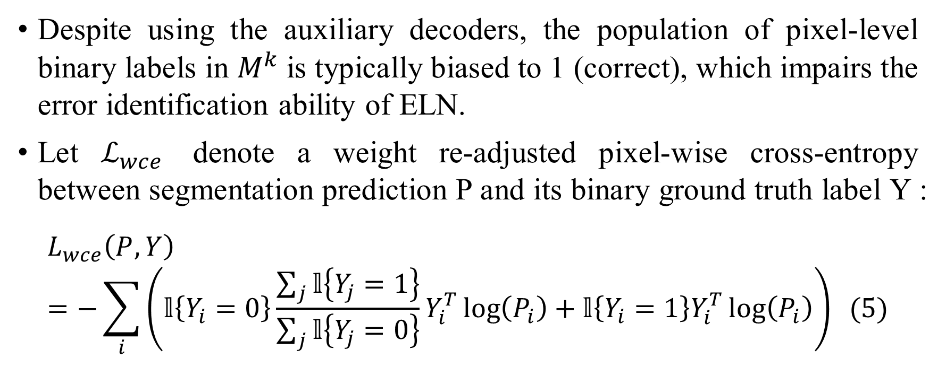
The loss function of ELN
Despite using the auxiliary decoders, the population of pixel-level binary labels in $M^{k}$is typically biased to 1 (correct), which impairs the error identification ability of ELN.
Let $ℒ_{wce}$ denote a weight re-adjusted pixel-wise cross-entropy between segmentation prediction P and its binary ground truth label Y :
$$L_{wce}\left(P,Y\right)=−\sum_{i}{\left(𝕝\left\{Y_{i}=0\right\}\frac{\sum_{j}{𝕝\left\{Y_{j}=1\right\}}}{\sum_{j}{𝕝\left\{Y_{j}=0\right\}}}Y_{i}^{T}\log\left(P_{i}\right)+𝕝\left\{Y_{i}=1\right\}Y_{i}^{T}\log\left(P_{i}\right)\right)} (5)$$
Notes:
作者在這邊提到，儘管使用了輔助decoder，𝑀^𝑘 中pixel level的binary labels的分佈通常偏向於1（正確），這樣會損害了ELN的錯誤辨別能力。
Let $ℒ_{wce}$ denote a weight re-adjusted pixel-wise cross-entropy between segmentation prediction P and its binary ground truth label Y
如果Yi是錯誤的pixel就把它乘上(其餘像素是對的總和除與其愈像素是錯的的總和),如果Yi是對那它的weigh就是1
這樣可以讓錯誤樣本得到更多的關注

Slide 20
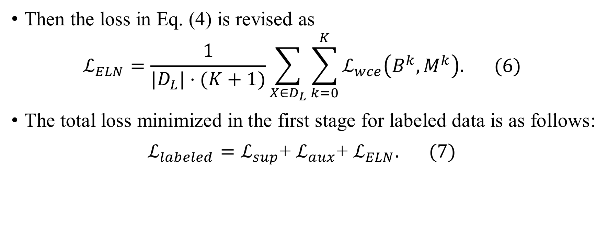
The loss function of ELN
Then the loss in Eq. (4) is revised as
$$ℒ_{ELN}=\frac{1}{|D_{L}|⋅(K+1)}\sum_{X∈D_{L}}{\sum_{k=0}^{K}{ℒ_{wce}\left(B^{k},M^{k}\right). (6)}}$$
The total loss minimized in the first stage for labeled data is as follows:
$ℒ_{labeled}=ℒ_{sup}$+ $ℒ_{aux}$+ $ℒ_{ELN}. (7)$
Notes:
有了剛剛的WCE就可以從寫Eq4
最終的損失函數會是$ℒ_{labeled}=ℒ_{sup}$+ $ℒ_{aux}$+ $ℒ_{ELN}$

Slide 21
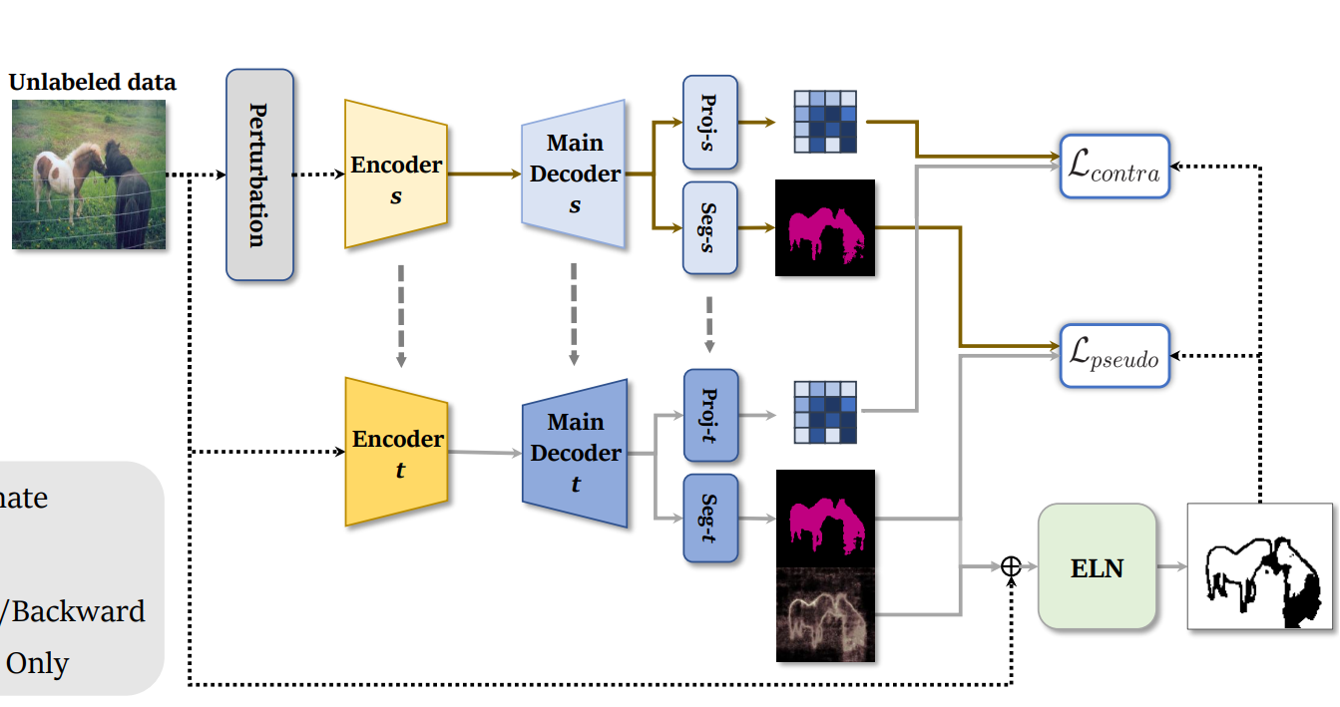
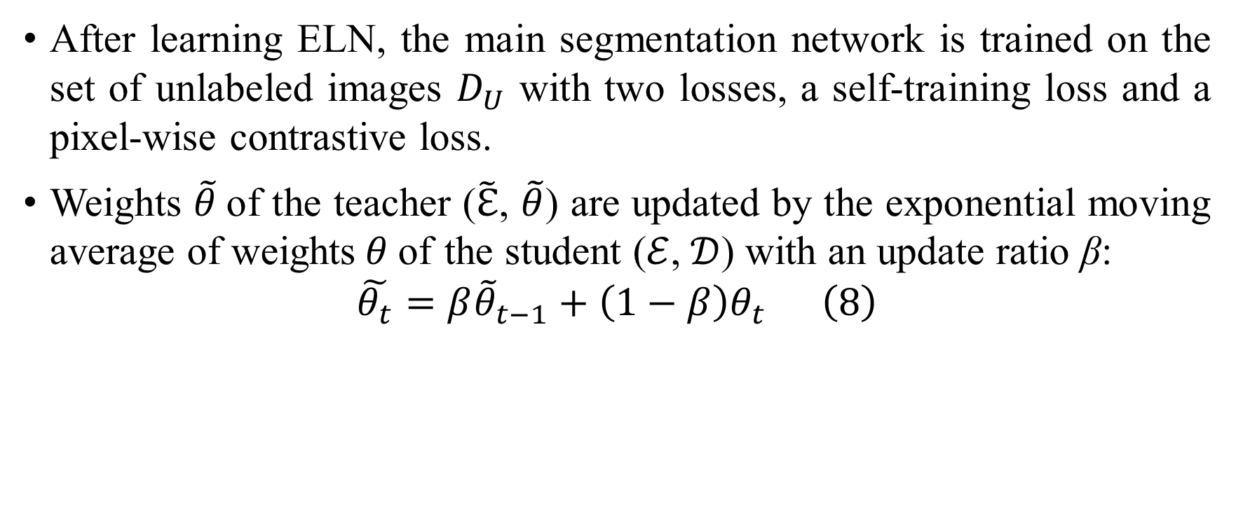
Semi-supervised Learning with ELN
After learning ELN, the main segmentation network is trained on the set of unlabeled images $D_{U}$ with two losses, a self-training loss and a pixel-wise contrastive loss.
Weights $\tilde{θ}$of the teacher ($\tilde{ℇ}$, $\tilde{θ}$) are updated by the exponential moving average of weights$θ$of the student ($ℰ$,$𝒟$) with an update ratio β:
$$\tilde{θ_{t}}=β{\tilde{θ}}_{t−1}+\left(1−β\right)θ_{t} \left(8\right)$$
Notes:
在學習了ELN之後，main segmentation network被訓練在unlabeled image 𝐷_𝑈 上，其中使用了兩個損失，self training 和 pixel-wise 的 contrastive loss。
這篇文章使用了mean teacher的架構，然後teacher model的weight tilde theta透過student model的weight theta 使用EMA的方式來更新,更新的比率是beta

Slide 22
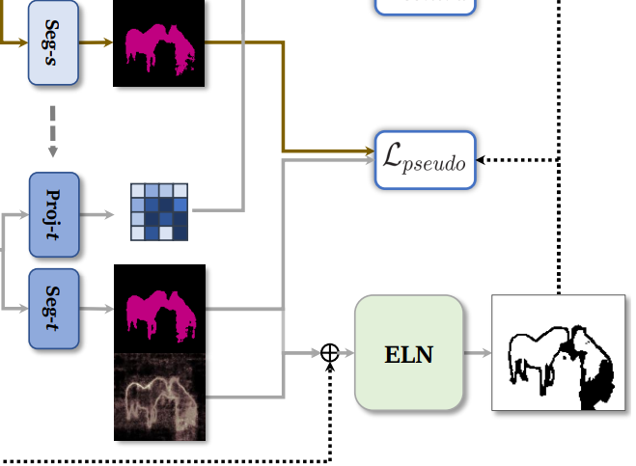
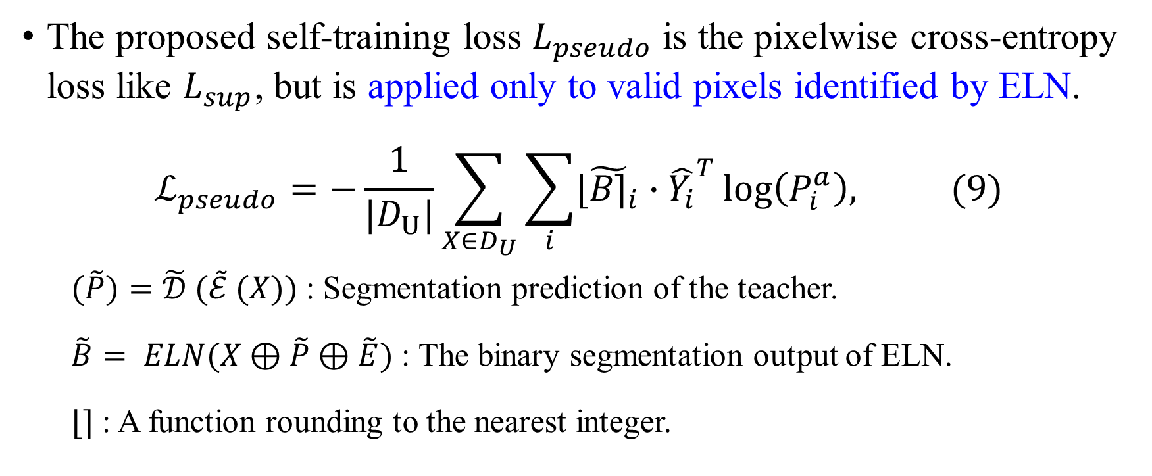
The proposed self-training loss
The proposed self-training loss $L_{pseudo}$is the pixelwise cross-entropy loss like $L_{sup}$, but is applied only to valid pixels identified by ELN.
$$ℒ_{pseudo}=−\frac{1}{|D_{U}|}\sum_{X∈D_{U}}{\sum_{i}{{\text{⌊}\tilde{B\text{⌉}}}_{i}}∙{\hat{Y_{i}}}^{T}\log\left(P_{i}^{a}\right), (9)}$$
$(\tilde{P})=\tilde{𝒟} (\tilde{ℰ} (X))$: Segmentation prediction of the teacher.
$\tilde{B}= ELN(X⊕\tilde{P}⊕\tilde{E})$ : The binary segmentation output of ELN.
⌊⌉ : A function rounding to the nearest integer.
Notes:
在pseudo label的loss中，相較於先前的supervised loss，它只使用了被ELN預測為正確的pixel.
先講一下 tilde B 是由Input image、 teacher model 的 predict 、 pixel-wise entropy map of tilde p 作 channel wise concate 出來的，在把它四捨五入，所以她就會變1 or 0
Yˆ i denotes the one-hot vector of the pseudo label for pixel i.
跟studen的predict算inner pordoct

Slide 23
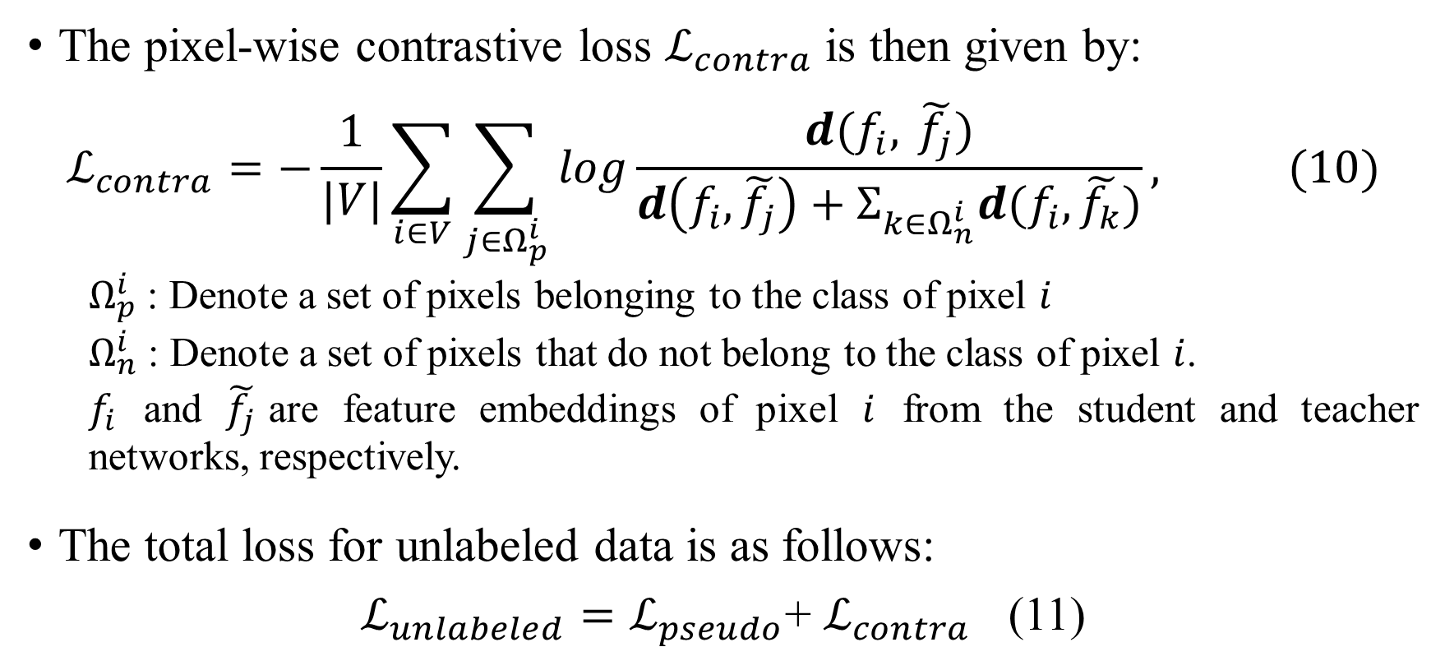
The pixel-wise contrastive loss
The pixel-wise contrastive loss $ℒ_{contra}$ is then given by:
$$ℒ_{contra}=−\frac{1}{|V|}\sum_{i∈V}{\sum_{j∈Ω_{p}^{i}}{log\frac{d(f_{i}, \tilde{f_{j}})}{d\left(f_{i}, \tilde{f_{j}}\right)+Σ_{k∈Ω_{n}^{i}}d(f_{i}, \tilde{f_{k}})}, (10)}}$$
$Ω_{p}^{i}$ : Denote a set of pixels belonging to the class of pixel $i$
$Ω_{n}^{i}$ : Denote a set of pixels that do not belong to the class of pixel $i$.
$f_{i}$ and $\tilde{f_{j}}$are feature embeddings of pixel $i$ from the student and teacher networks, respectively.
The total loss for unlabeled data is as follows:
$ℒ_{unlabeled}=ℒ_{pseudo}$+ $ℒ_{contra}$ (11)
Notes:
In order to further improve the quality of learned features, we adopt a pixel-wise contrastive loss Lcontra.
具體而言，在這個損失中，具有相同pseudo label的feature在feature space中互相吸引，而來自不同類別的特徵則被推開。
d : distance function, $d(f1, f2) = exp⁡(cos⁡(f1, f2)/τ ).$
V denotes the set of valid pixels on DU

Slide 24
Experiments

Slide 25
Dataset
PASCAL VOC 2012
Classes: 21
Training set: 1464
Val set: 1449
Testing: 1456
Resize image: 512*512
Cityscapes
Classes: 19
Training set: 2975
Val set: 500
Testing: 1525
randomly cropped image: 512 × 1024

Slide 26
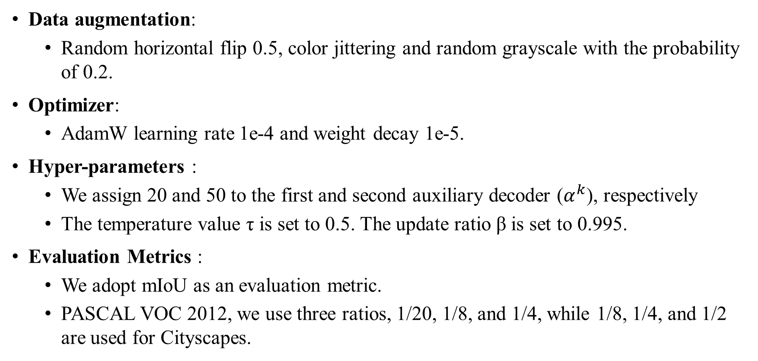
Implementation Details
Data augmentation:
Random horizontal flip 0.5, color jittering and random grayscale with the probability of 0.2.
Optimizer:
AdamW learning rate 1e-4 and weight decay 1e-5.
Hyper-parameters :
We assign 20 and 50 to the first and second auxiliary decoder ($α^{k}$), respectively
The temperature value τ is set to 0.5. The update ratio β is set to 0.995.
Evaluation Metrics :
We adopt mIoU as an evaluation metric.
PASCAL VOC 2012, we use three ratios, 1/20, 1/8, and 1/4, while 1/8, 1/4, and 1/2 are used for Cityscapes.

Slide 27
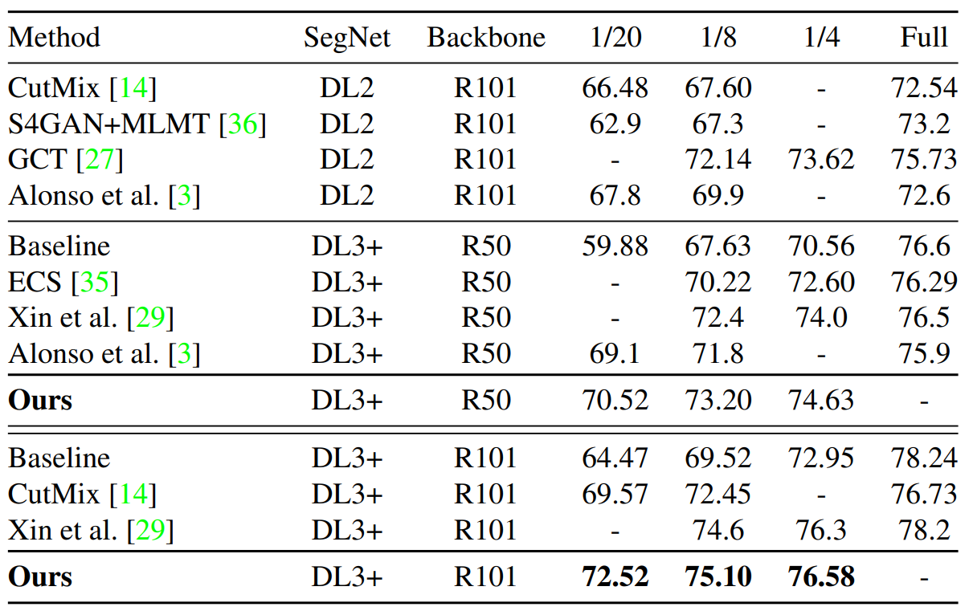
PASCAL VOC 2012 val set
Notes:
mIoU value in the PASCAL VOC 2012 val set with different labeled-unlabeled ratios. All results of our experiments are averaged from three different subsets of the same ratio.

Slide 28
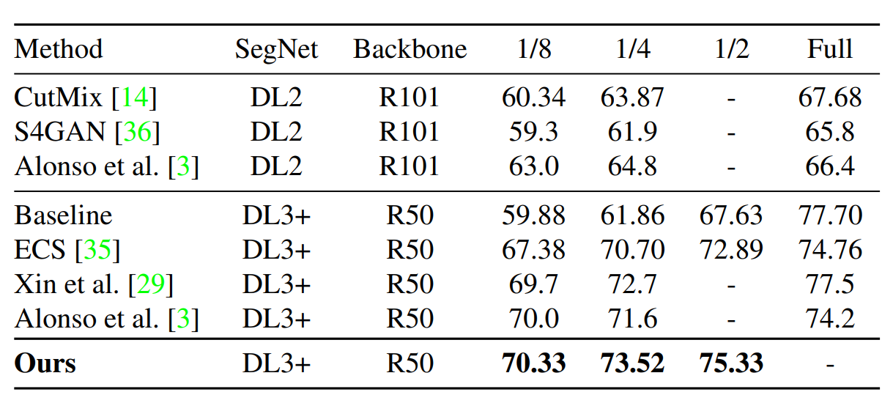
Cityscapes val set

Slide 29
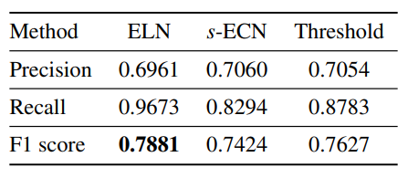
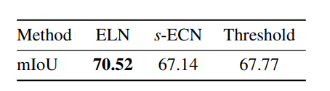
Performance analysis on error localization network
We conduct experiments on the ratio of 1/20 to PASCAL VOC 2012 with ResNet-50 as a backbone network. As the first thing to compare, we consider a simple error correction network (s-ECN) which has a similar learning strategy as ELN.

Slide 30
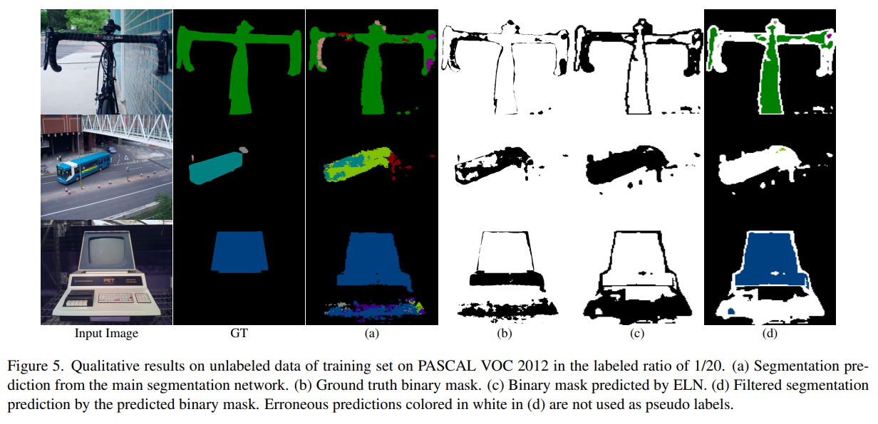
Training set on PASCAL VOC 2012

Slide 31
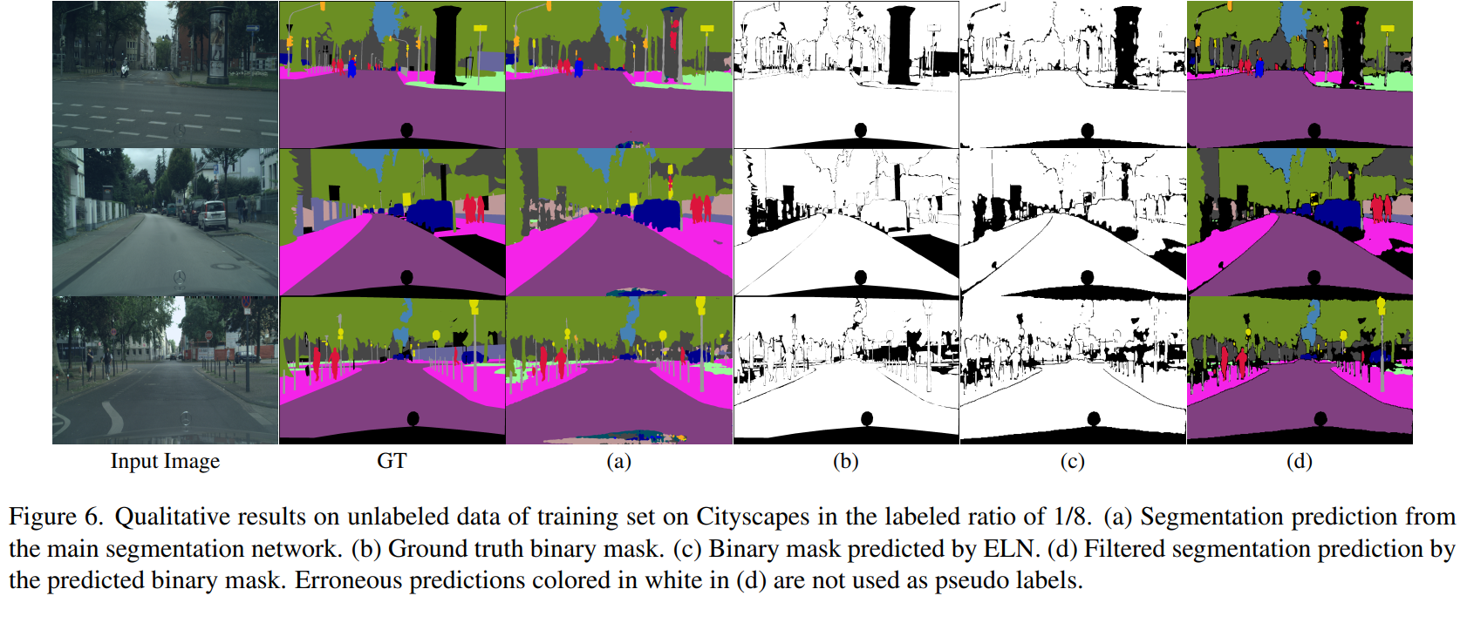
Training set on Cityscapes

Slide 32
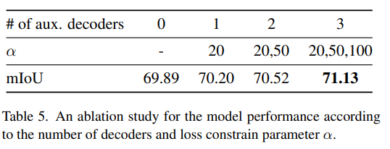
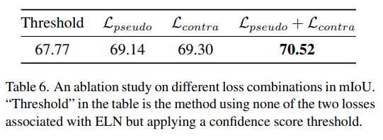
Ablation studies

Slide 33
Conclusion

Slide 34
Conclusion
We have presented a novel training framework suitable for semi-supervised semantic segmentation tasks.
To mitigate the performance degradation caused by confirmation bias due to invalid pseudo labels, we have proposed error localization network (ELN) and its training scheme.
Our experiments validated that ELN effectively removes error of pseudo labels for unseen data, which demonstrate that our learning strategy using erroneous predictions simulated by auxiliary decoders is helpful. Our method achieved the state of the art on both of the PASCAL VOC 2012 and Cityscapes datasets with high generalization capability.
Notes:
我們提出了一種適用於semi-supervised sematic segmentation的新型訓練框架。
為了減輕由於無效pseudo label而導致的confirmation bias而引起的性能下降，我們提出了錯誤定位網絡（ELN）及其訓練方案。
我們的實驗驗證了ELN有效地消除了unseen data 的 pseudo label error，這表明我們提出的方法是有幫助的。
我們的方法在PASCAL VOC 2012和Cityscapes數據集上都達到了SOTA，具有高度的泛化能力。

